Slide 1
The Leading Enterprise Community Platform for Associations

Slide 2
About Your Organization…
Number of member orgs, individuals, member types, growing?
Your technology—AMS/CRM, Email, CMS, LMS, etc.?
Current tool for member collaboration?
What’s driving the interest/project?
Project timing & budgets we should be aware of

Slide 3
Welcome + Agenda
WHO
Is Higher Logic
WHAT
Does Higher Logic Provide
WHERE
Does Higher Logic Fit
WHEN
To Partner
WHY
Should You Invest
Demonstration and Questions

Slide 4
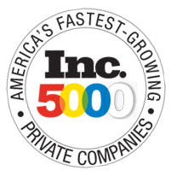
The Higher Logic Difference
Experience: 250,000+ Communities
Inc. 500–5000: Strong, Private Companies
50 Great Places to Work
98% Retention Rate of Clients
AMS & CRM Secure Integration
Accessibility (IAAP)
Guided Implementation & Best Practices
Notes:
Why Higher Logic? Higher Logic’s mission is to bring like-minded people together in secure communities designed to enable relevant and purposeful interactions, ignite knowledge sharing, drive content creation and improve performance. With Higher Logic associations can provide a platform for collaboration to build a dynamic, engaged and happy member base. We’re different because of:
Our association experience
Our technology
Our commitment
Our team
Put simply, we have the best team in the business. Our obsession with client satisfaction is unmatched, and is backed up by our 97% retention rate. We not only have a proven track record of success and a highly credentialed, experienced staff, we also have a solid vision for growth. We maintain a constant focus on what is needed to enhance our client experience now and into the future. If your community is not successful, we are not successful. As a result, we have a vested interest in making sure your experience is positive and enduring.
QUOTE: “We are currently working with a total of six vendors on our various projects. The Higher Logic team stands head-and-shoulders above the rest. Your crew is helpful, responsive, on top of things and above all, really fast!” - NYSBA

Slide 5
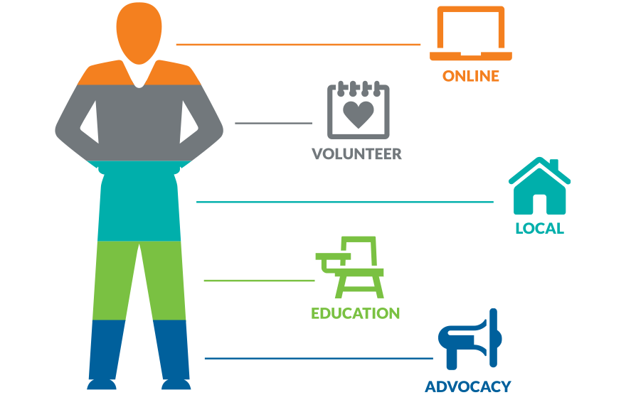
Higher Logic Builds Engagement
Increase Engagement
Track Volunteering
Component Tools
Learning Management
Notes:
What we do? Engagement. Higher Logic builds engagement.
Increase engagement in volunteering
Track volunteering at all levels
Make a system that is easy to use

Slide 6
Higher Logic Can Help
RETURN
On Engagement
INCREASE
Retention Rates
BUILD
Search Engine Optimization
GROW
Your Member Base
EXPAND
Business Intelligence

Slide 7
Online Community
DISCUSSION GROUP
RESOURCE LIBRARIES
DIRECTORIES
BLOG / WIKI GLOSSARY
EVENT CALENDARS
RESPONSIVE DESIGN
AUTOMATION RULES
ANALYTICS
GAMIFICATION

Slide 8
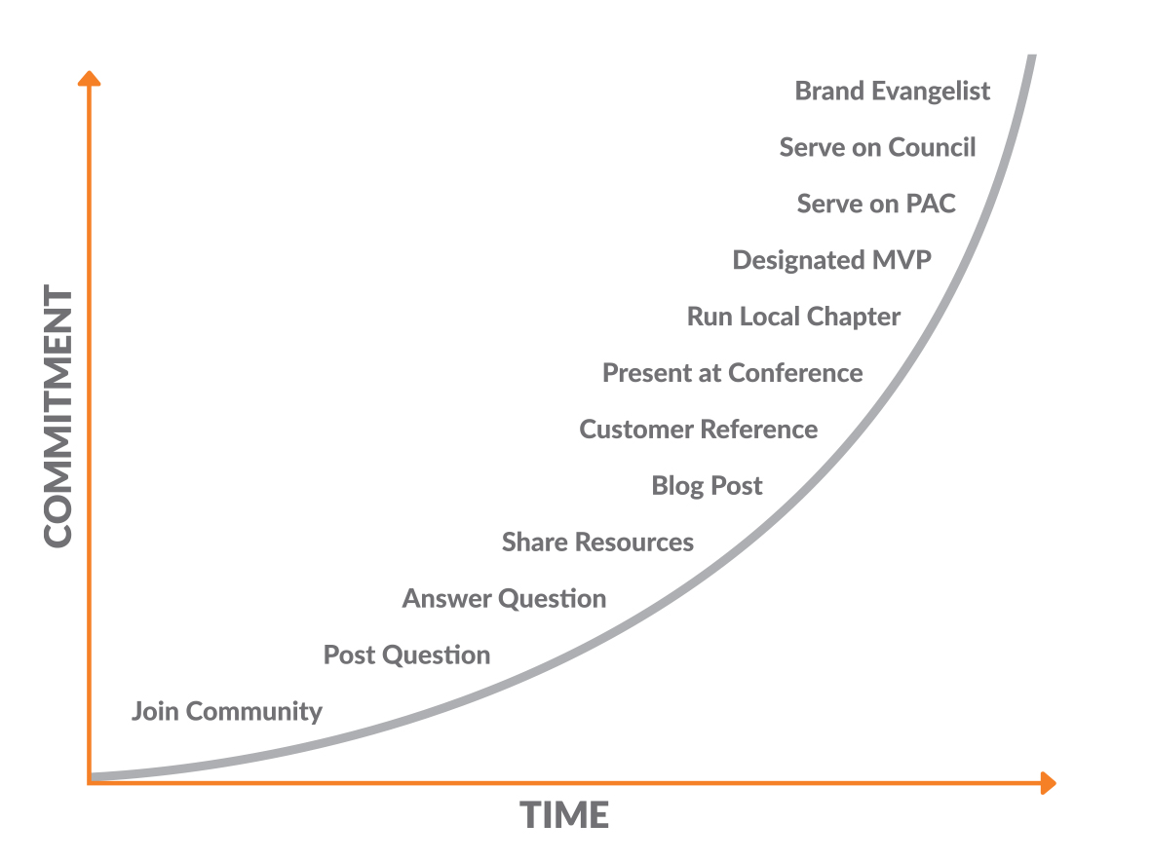
Community Lifecycle Curve
Notes:
Just because you have one, doesn’t mean people will use it.

Slide 9
Right Message, Person & Time
Fewer than 1,000 Contributor Points
Not Received Campaign within 90 Days
Started Thread in Last 5 Days
People in the overlap section will get the email
Notes:
Closing the Volunteer Gap The right message, the right person at the right time.
We know there is willingness to help
All we have to do is ask
How do we get the right opportunity to the right volunteer at the right time?

Slide 10
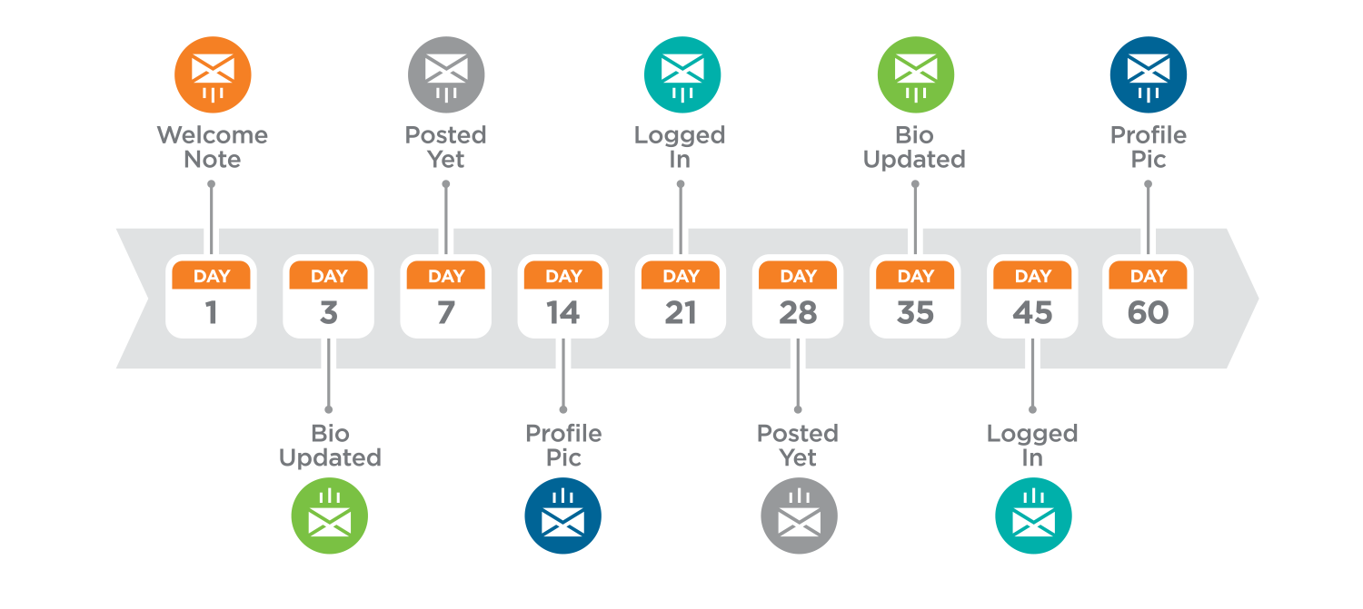
New User Welcome Campaign
Automation Rules Example
Notes:
Most critical time for your customers. Onboarding.
What should I do on day 1? Day 3? Day 6?

Slide 11
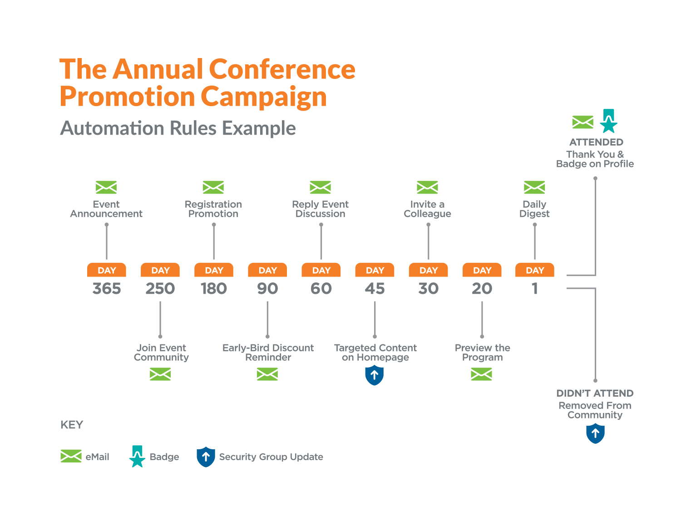

Slide 12
Conversion Rate Success
TOP FIVE EMAIL CONVERSIONS CHART
RULE | TOUCHES | NUMBER CONVERTED | CONVERSION PERCENT
1. Discussion Author with no Photo | 103 | 45 | 43.69%
2. Keep the Conversation Going | 94 | 34 | 36.17%
3. Welcome New Member | 353 | 89 | 25.21%
4. Your First Post with Photo | 65 | 14 | 21.54%
5. We Miss You (Second Touch) | 30 | 4 | 13.33%
Source: ASAE Automation Rules Conversion Report, 2015

Slide 13
New Member Welcome Campaign
Professional Photographers of America (PPA)
Goal: Welcome new members and get them to engage in the community within the first week of joining PPA.
Program: Members within their first week of joining the community.
Results:
73% took action and logged into the community
15% updated their profile bio
12% posted at least one message
148 posts, 3% of all posts in that 30 days
Notes:
Case study on automation rules- Goal= the automation rule they used

Slide 14
We Miss You Campaign
American Association for Respiratory Care (AARC)
Goal: Re-engage with former active members in 105 days
Program: Members who had written 4+ discussion posts, but no post in last 90 days
Results:
26% posted a message
15% posted within a month
Averaged 3 posts per member
This group accounted for 25% of all posts
Notes:
Imagine if we could get customer reengaged before their reneal is up

Slide 15
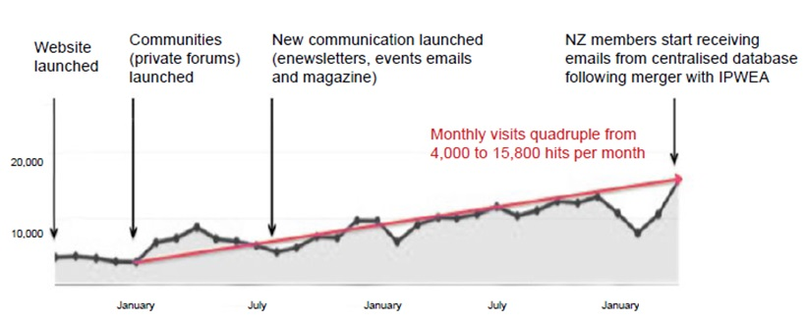
Case Study: IPWEA
70% membership growth, prospects doubled and hits quadrupled
Notes:
Content marketing strategy- best customers to find more customers
Case Study: IPWEA IPWEA’s membership has gone from 2,000 to 3,700 in 18 months due to a merge of NZ with their organization. This merge was largely facilitated by their sister NZ organization wanting to provide its members with access to the type of services that IPWEA has been able to provide, i.e., the private and very active (HL) communities of practice, website, content, magazine, eNewsletters, etc. (Beyond the merger that was driven by HL’s communities, the net increase in membership in 2014 was an impressive 11%, also due to IPWEA’s community success).

Slide 16
Case Study: IPWEA

Slide 17
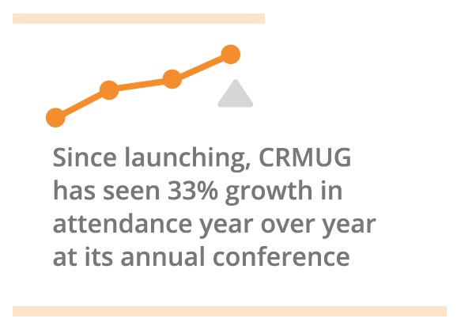
Communities Drive Event Growth
“Summit, our annual conference, comprises 60% of our annual revenue. CRMUG Collaborate drives 10x more registrations than any other source.”
Andy Hafer Chief Executive Officer

Slide 18
Content Drives Event Attendance
4,029 AXUG
3,174
CRMUG
DOWNLOADS FROM THE
12,948 SUMMIT LIBRARIES
1,436
NAVUG
4,309 GPUG
Notes:
This is one month post event
Source: Higher Logic Dynamic Communities Case Study Dynamic Communities, Inc. launched its first community in 2012, CRMUG Collaborate. Early on, Dynamic Communities realized its CRMUG community would be a great vehicle to promote conferences and events and drive better attendance. They receive ten times more registrations coming from the online Higher Logic community to their annual conference, Summit, than any other source. Since launching, Summit has seen 33 percent growth in attendance year over year at its annual conference, which has added to strong revenue growth.

Slide 19
Notes:
Source: Higher Logic AANAC Case Study
Discussions in Action Infographic – shows how AANAC took online education and continue the conversation online in ANNAC Connect. They were able to measure many things, and this is the graphic story.

Slide 20
Additional Features
ACTIVITY SYNC
COMMUNITY & EVENT APPS
COMMUNITY MANAGEMENT
CONTENT MANAGER
EVENT MANAGER
EXPERT DIRECTORY
MENTOR MATCH
VOLUNTEER MANAGER

Slide 21
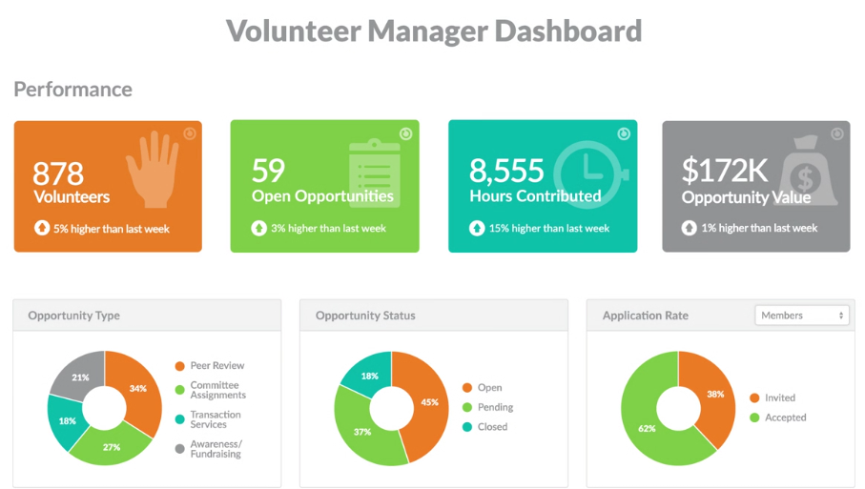
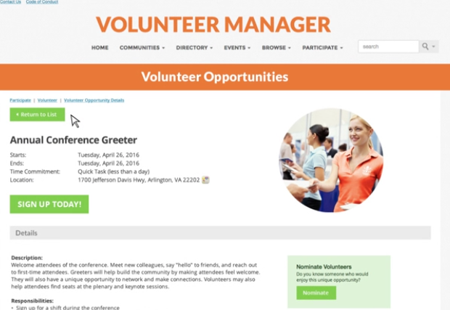
The Volunteer Process
CREATE
REPORT
TARGETED ASK
VOLUNTEER
REWARD
REVIEW
Notes:
NOTE FROM LAUREN: Infographic 3 Option

Slide 22
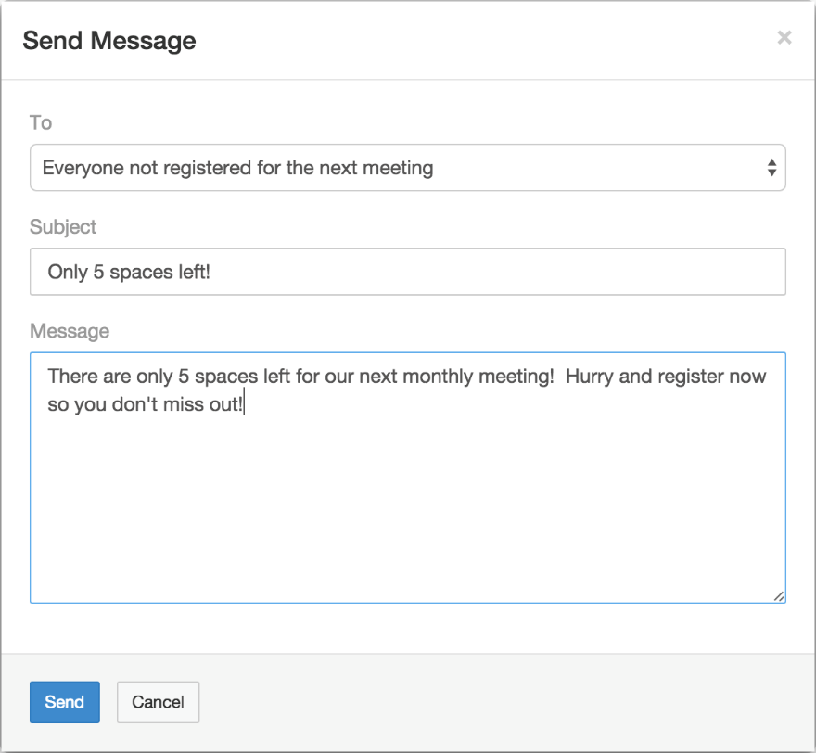
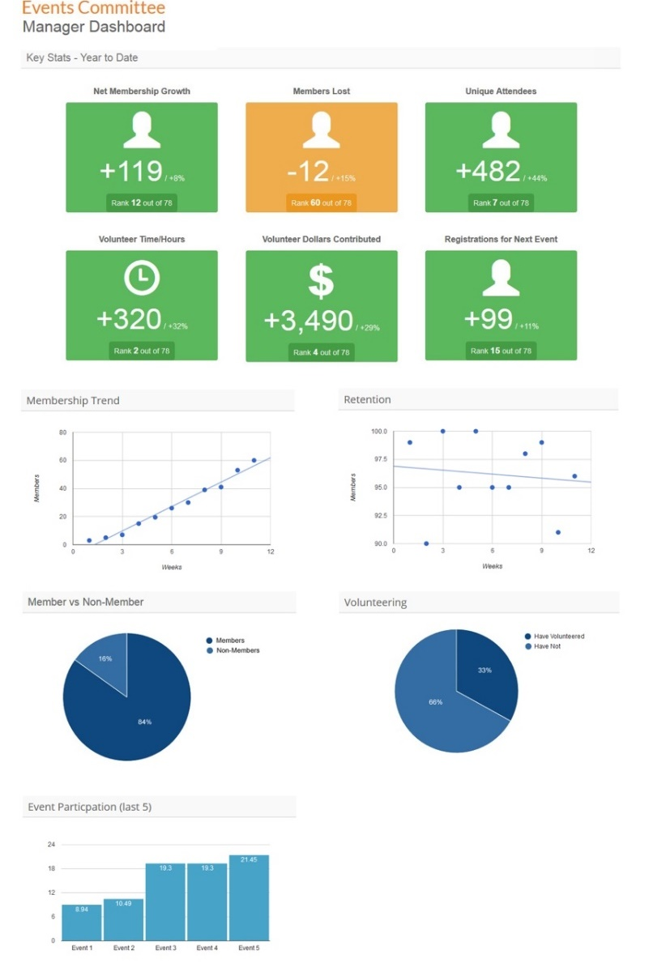
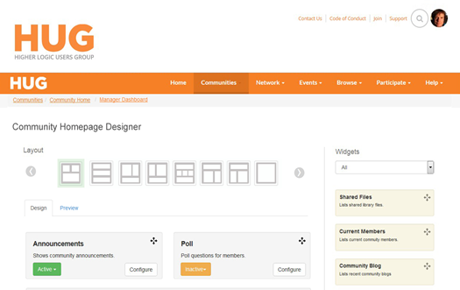
Give Component Leaders Tools
Get Data In Return

Slide 23
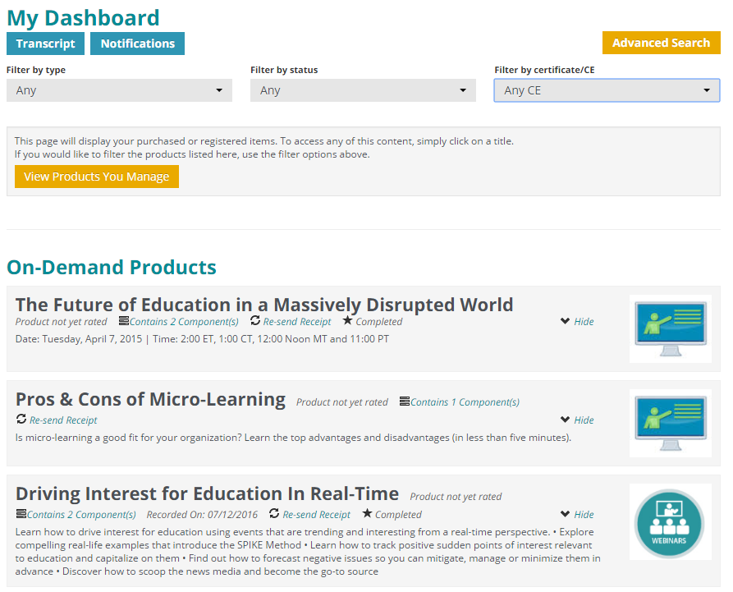
Learning Management System

Slide 24
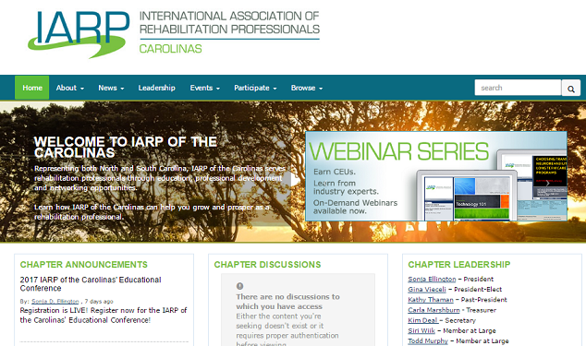
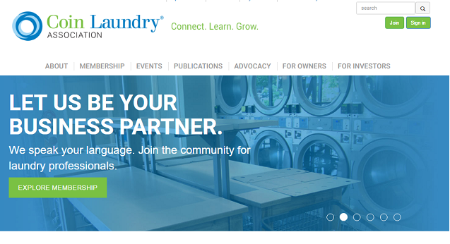
Content Manager
Main www
Chapter Websites
Event Websites
Branded initiatives

Slide 25
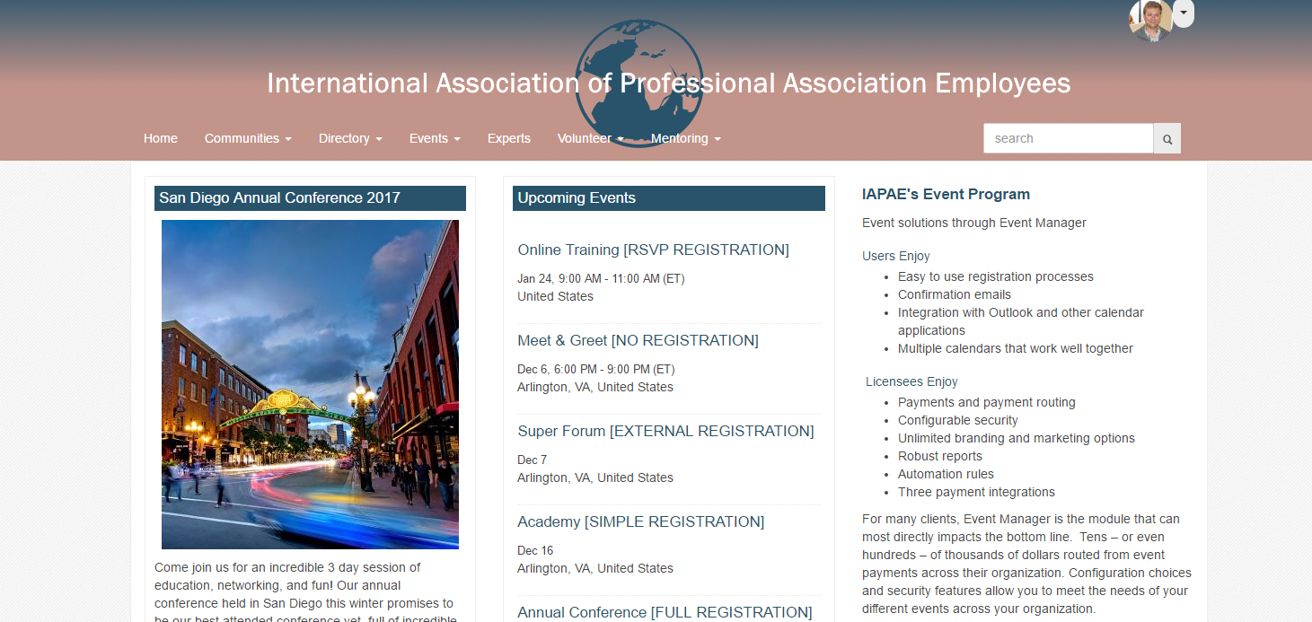
Event Manager

Slide 26
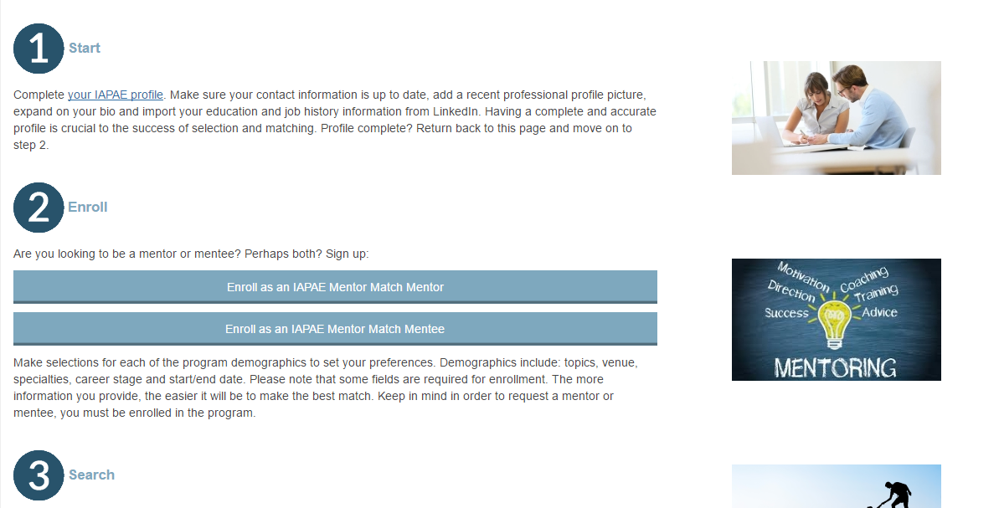
Mentor Match

Slide 27
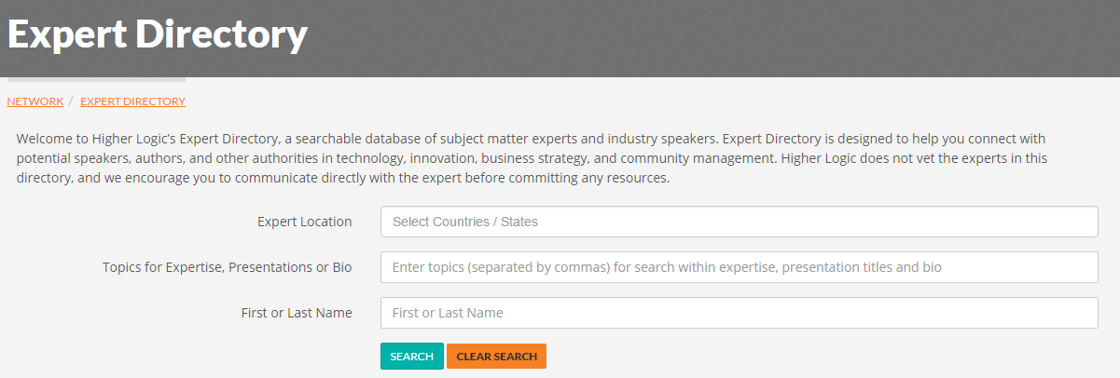
Expert Directory

Slide 28
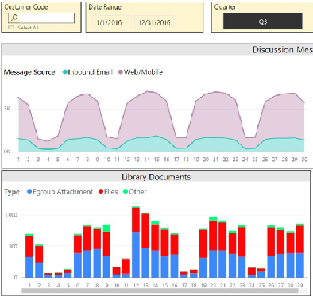
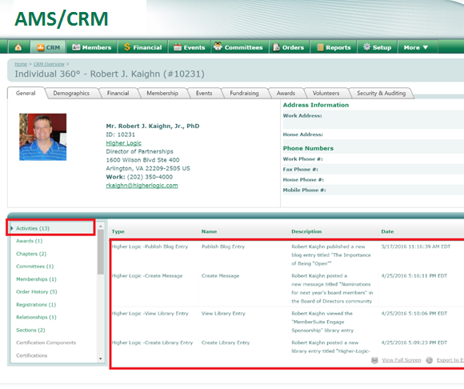
Activity Sync

Slide 29
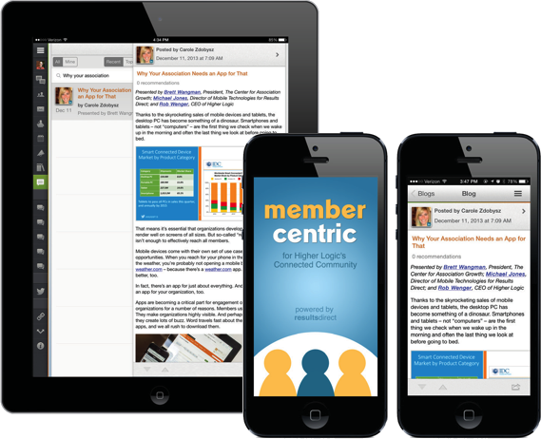
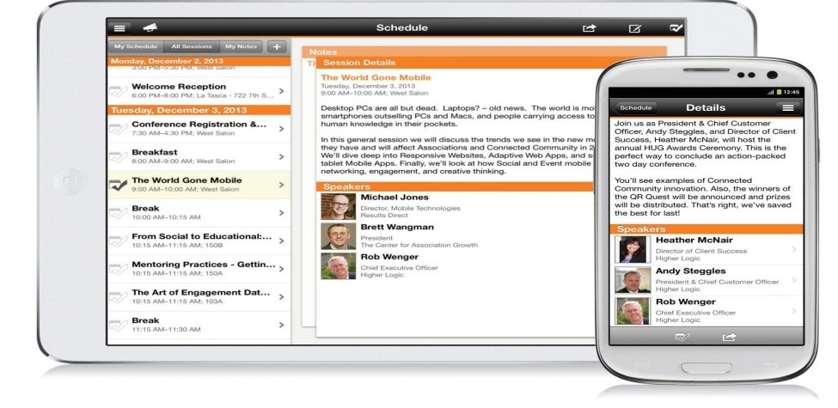
Community & Event Apps
MemberCentric
Eventsential
Eventpedia

Slide 30
Community Management
Designated community manager who works with your staff to support community strategy and engagement and can also provide community support to your members

Slide 31
Right SOLUTION for the Right CONSTITUENT
COMMUNITY MEMBER
“ The community has become a robust collegial network where I can always find the help I need.”
“ I have found it to be very useful to connect with other customers and am happy with the amount of feedback I’ve received.”
COMMUNITY MANAGER
“ Higher Logic gives me the tools I need to provide the best possible experience to my members. It’s a software platform built for the demands of today’s community professionals.”
ASSOCIATION LEADERSHIP
“ The best thing we’ve done in the last 15 years is launch Collaborate”
“ Higher Logic has become one of our most popular member benefits. Members say it’s an integral part of their work day”
Information Technology
“ Higher Logic has great features and this really is our one benefit that we offer to all members.”
“ Higher Logic helped us dramatically simplify our IT infrastructure. We were able to retire our email list, our online discussion software, and a custom-developed member directory.”
Notes:
BENEFITS/FEATURES
Community Members:
Valuable user-generated content, opportunity to share insights in one-of-a-kind knowledge center
Collaboration and interaction with peers/like-minded audience – a home where they can meet, share ideas and answer questions
Meaningful frictionless engagement, opportunity to easily access and participate in discussions anywhere, anytime, on any device
Networking made easy - automatically pulls in profile data form existing enterprise systems & social networks
Intuitive interaction from within the community that can be easily customized with CSS- user interface/experience
Community Managers:
Easy-to-use platform to facilitate and control discussions with role-based access
Report and measure member engagement and interaction – dashboards, built-in and custom reporting tools. We have any engagement data a CM would need.
Time-saving tools/programs for onboarding and renewals - Targeted automated member outreach and engagement tools – prebuild and custom automation rules
Members can find what they need with faceted search
Sales/Marketing/Product:
Access to meaningful, real conversations about customers needs/wants/challenges
Ideation - Real-time discussions/user-generated content giving insights on product/service feedback
Full controlled access to MVPs, with lead gen/customer upsell opportunities
SEO
Advertising revenue with banners and sponsorships of digests and blogs
IT:
Secure platform environment, with different levels of security settings/access/control
Pre-built integration with CRM/Support/Email/Marketing platforms, with all-in-one connected ecosystem
Data on engagement with pre-built and custom reporting capabilities

Slide 32
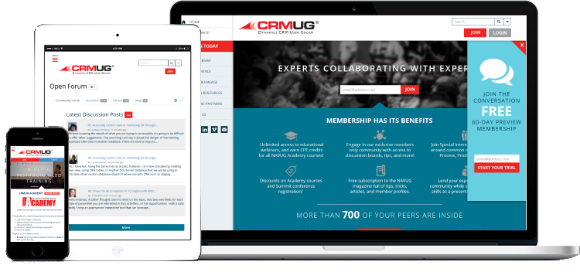
COMMUNITY MEMBER: Works How People Work
RIGHT PLATFORM, RIGHT TIME, ANY TIME
Engage wherever/whenever
Intuitive interaction
Connect with people like you
Notes:
Right platform, right time, any time:
Engage from wherever you are: Daily digest in email – learn and engage right from email (frictionless). Stats for daily emails sent across clients
Intuitive interaction from within the community - user interface/experience, (knock on jive… with just long discussion threads & less organization)
Connect w people like you: (LinkedIn connectivity Build networks of like backgrounds, locations, types of product usage) --- automatically pulls in profile data form existing enterprise systems & social networks
IDEAS FOR IMAGES –
show data may come from multiple data sources – i.e. connection with CRM and others using similar products… (i.e. the PRO community vs the ENTEPRRISE community) show interface on mobile/multiple devices, show imported social data
TALKING POINTS: best customers to weave into this discussion?
Community Members:
Valuable user-generated content, opportunity to share insights in one-of-a-kind knowledge center
Collaboration and interaction with peers/like-minded audience – a home where they can meet, share ideas and answer questions
Meaningful frictionless engagement, opportunity to easily access and participate in discussions anywhere, anytime, on any device
Networking made easy - automatically pulls in profile data form existing enterprise systems & social networks
Intuitive interaction from within the community that can be easily customized with CSS- user interface/experience
I mentioned earlier that we consider our solution to be a Customer Engagement Platform.
We realized this about three years ago, as a difference from our previous way of thinking of our solution as an online community platform
This realization really helped us to both narrow our focus on what we do to improve the product, as well as to expand our thinking on what we should include in it.
So, for example, when you focus on Engagement, things like removing all barriers to engagement become VERY important.
The first thing we did was to kick off what we called “the frictionless project” where we focused our efforts on removing anything that might get in the way of a community member participating.
So, for example, we converted everything to Responsive design so that all community features can be used on any device.
We also made it so that users can respond to threads or start new threads through their email client, even if responding via the daily digest.
We made it so that attachments to email messages sent into the community put the files in the resource library associated with the discussion group. Etc.
All with the goal to make it SO EASY to engage that the user doesn’t think twice about doing it.

Slide 33
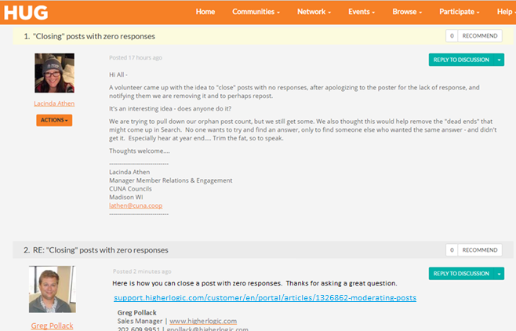
Frictionless Engagement & Daily Digest
Notes:
As you can see, his reply is now part of the discussion and he never had to visit the
There are others ways we make it easy for people to engage and connect.
<click>

Slide 34
COMMUNITY MANAGER: Drive Excellence
TOP FIVE EMAIL CONVERSIONS
RULE | TOUCHES | NUMBER CONVERTED | CONVERSION PERCENT
1. Discussion Author with no Photo | 103 | 45 | 43.69%
2. Keep the Conversation Going | 94 | 34 | 36.17%
3. Welcome New Member | 353 | 89 | 25.21%
4. Your First Post with Photo | 65 | 14 | 21.54%
5. We Miss You (Second Touch) | 30 | 4 | 13.33%
Source: ASAE Automation Rules Conversion Report, 2015
BUILT WITH COMMUNITY MANAGERS IN MIND
Targeted and automated member outreach
Measure and report on engagement and interaction
Facilitate and control discussions
Notes:
Community Managers:
Easy-to-use platform to facilitate and control discussions with role-based access - permission based access (UX, navigation, groups…), moderation
Report and measure member engagement and interaction – dashboards, built-in and custom reporting tools. We have any engagement data a CM would need.
Time-saving tools/programs for onboarding and renewals - Targeted automated member outreach and engagement tools – prebuild and custom automation rules with conversion metrics
Members can find what they need with faceted search
Ideas for images: dashboard of automation rules conversion report.
Customers to weave into the discussion:

Slide 35
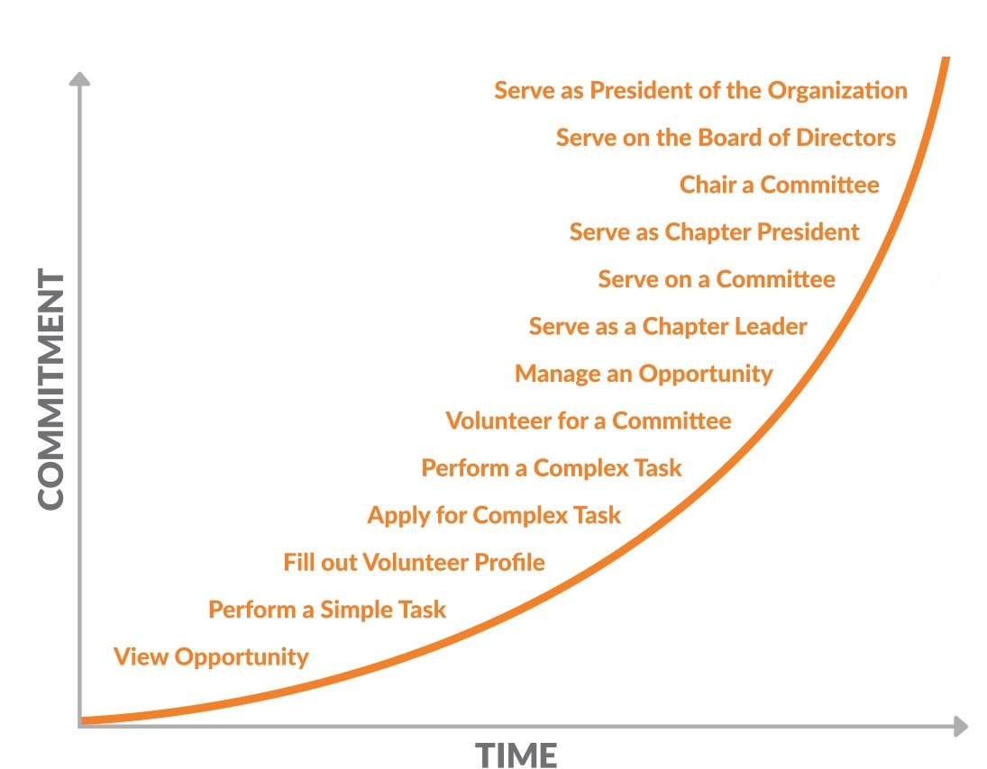
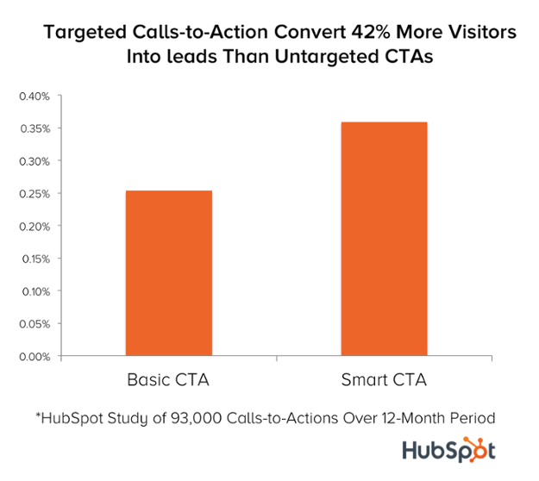
Automation Rules: Member Lifecycle Curve
Personalized CTAs Convert 42% Better

Slide 36
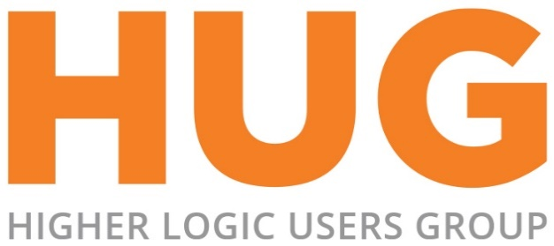
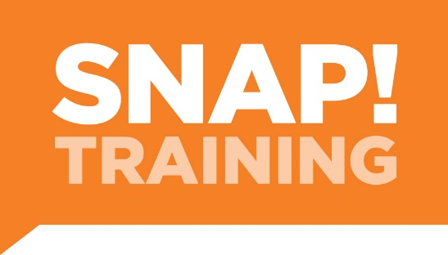
Education, Training & Support

Slide 37
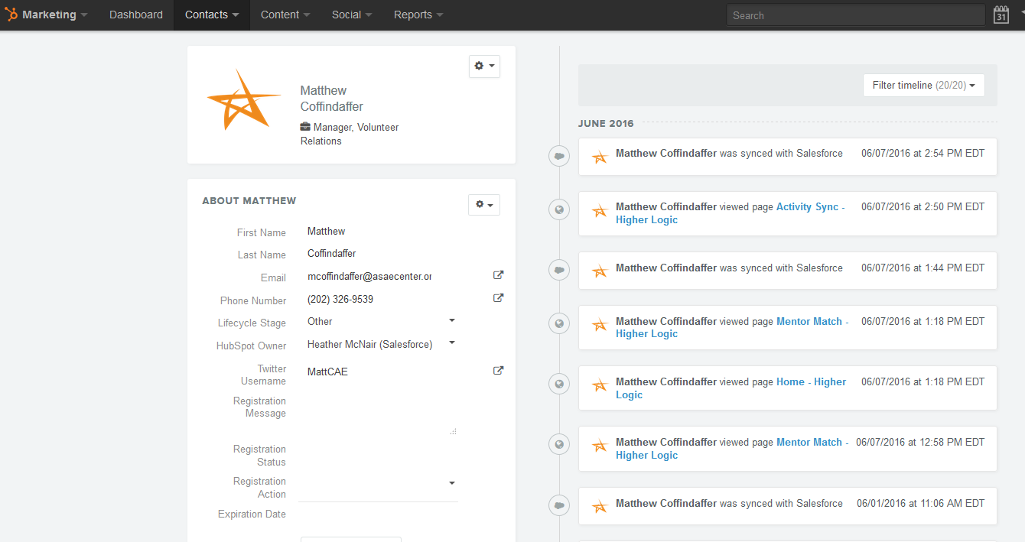
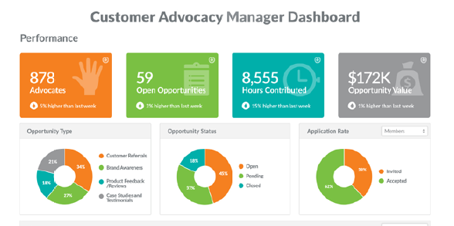
ASSOCIATION LEADERSHIP: Measured Results
ASSOCIATION LEADERSHIP
Return on Engagement
Increase in Renewals
Additional Non-Dues Revenue

Slide 38
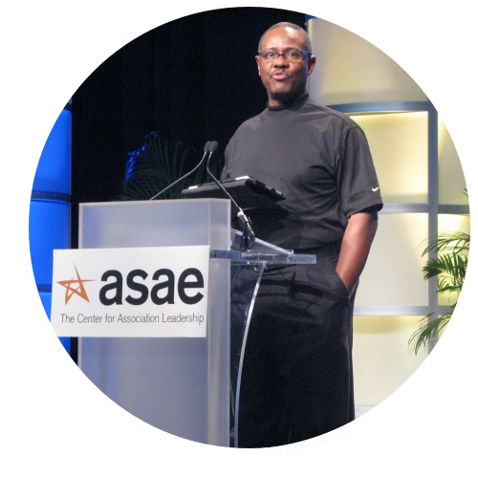
Reggie Henry, CAE, CIO of ASAE
@ReggieHenry: The best thing we’ve done in the last 15 years is launch Collaborate @HigherLogic!

Slide 39
30% More Likely to Recommend
AMOUNT | NON-COLLABORATE | COLLABORATE
≤ $600 | 45.5% | 12.9%
$600-$1600 | 18.5% | 15.2%
$1600-$3000 | 13.9% | 15.2%
> $3000 | 22.1% | 56.7%
LOGIN TOTAL | NPS
0 | 17.1
1-2 | 26.1
3-4 | 36.7
5+ | 41.2
Notes:
Source: ASAE NPS Survey said that members who are active within Collaborate are 30% more likely to recommend ASAE to a friend or colleague.

Slide 40
Information Technology: Even Love Higher Logic
Information Technology
Rapid implementation
Prebuilt APIs
Integrates with other enterprise solutions
Notes:
Fast implementation /
Prebuilt APIs for top 40 applications (OLD SCHOOL - system calls out directly to the CRM etc. every time you log in; vs just call on changes)
integrate w enterprise solutions
Single data source – easy for IT department to pull out data
Cloud ---
Out of the box integration into the full customer ecosystem.
How do we do this better, faster than others? Answer, pre-built standard APIs and Push API with main CRM vendors.
Why is it important? Faster time to launch and don’t need 3rd party SI or consultant
Ideas for images:
Customers to weave into the discussion:

Slide 41
Implementation Timeline
START
WEEK 1
WEEK 2
WEEK 3
WEEKS 4-6
WEEKS 6-8
WEEKS 8-10
WEEKS 10-12
Discovery Call
Technical Worksheet
Technical Call
Design Meeting
Site Design
and Setup
Data Q/A
Beta Testing/ Site Review
Higher Logic Academy
Integration and SSO Development
Training, Engagement Strategy and Testing

Slide 42
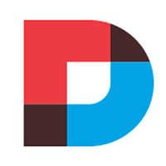
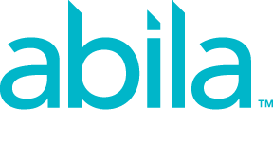
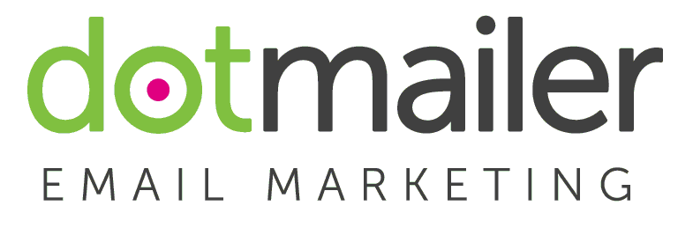
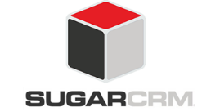
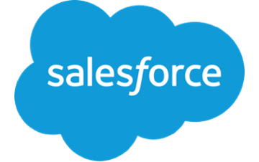
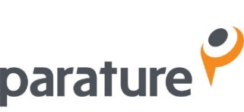
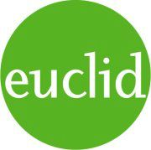
Integration with critical systems

Slide 43
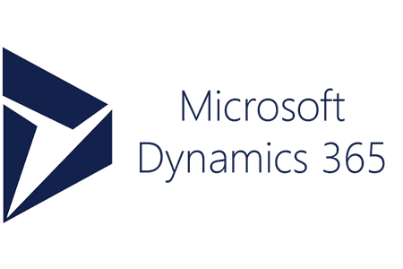
Notes:
Database integration – Higher Logic is vendor agnostic and integrates seamlessly with more than 40 major AMS, CRM and database vendors. That means your new online community is full on day one, and member information is always synchronized across both systems. In addition, Connected Community is a cloud-based SaaS (software as a service) platform. That means associations require absolutely no additional IT staff for support or maintenance. Higher Logic just works – easily and securely – from the very start.
Personal Information
Email
Browse History
Search History
Content Subscriptions
Personal Profile
Files
Images
Tags
Market
Purchases
Writing
Bookmarks
Mobile
Lists
Groups
Relations
Collaborations
Networking
Member Matching

Slide 44
CASE STUDY:
Higher Logic AANAC
Notes:
Source: Higher Logic AANAC Case Study
Discussions in Action Infographic – shows how AANAC took online education and continue the conversation online in ANNAC Connect. They were able to measure many things, and this is the graphic story.

Slide 45
Happy Higher Logic Clients
“ Our engagement increased 300% in the last year! Higher Logic was instrumental in helping us educate our members on how to use their platform and that education really paid off.”
“
“ Higher Logic has become one of our most popular member benefits. Members say it’s an integral part of their work day.”
www.higherlogic.com/reviews
Notes:
Higher Logic is designed to empower relationship building and foster community evolution, which we believe are the fundamental elements to the long-term relevance of any organization. We’re committed to your success because community is what we do, it’s our passion. And we have happy clients. Check out client reviews on our website at www.higherlogic.com/reviews.

Slide 46
Generate Additional Revenue
“ We’ve seen great success with the discussion group email sponsorships. Priced at $2,500 per month, this spot has been booked up all year long, and is completely booked for next year as well.”
Greg Cook Senior Director of Advertising & Media Solutions
“
Notes:
New Opportunities Not only do members benefit from enhanced services, but your organization can realize opportunities not historically available to it. You can generate new revenue streams by allowing advertising or sponsorship opportunities in your community.

Slide 47
Our Customers Reach the FINISH LINE
MANY STARTING POINTS:
ONE FINISH LINE:
Increase Retention Rates
Grow Member Base
Expand Business Intelligence
ENGAGEMENT = Continued usage, new sales, customer evangelists.
Notes:
I should take a minute here to explain that we consider ourselves an Engagement platform, as opposed to a Collaboration platform.
Our goal is to get our clients’ customers to engage with one another. To ask questions and get answers.
To share best practices. To network. To keep up with what is going on in their industry, on a daily basis.
I point this out to differentiate us from something like Yammer or Chatter or Slack, which are built more for collaboration.
Like real-time work on a project or deal.
I also should differentiate us from what I call wide-but-shallow communities that you only visit once or twice when you have a problem.
We work with our clients to create REAL communities. Groups of people who really want to talk to one another and get to know one another.
We have a litmus test: “If your members or customers wouldn’t mind getting one email from the community per day, then our solution is a great fit.”
For example, we run communities for the Microsoft Dynamics products.
The members of these communities are generally administrators of those products
In other words, being up to date on what is going on with, say Dynamics CRM, is important to their job.
They WANT to hear the questions others are asking, and the solutions they are coming up with.
Would this work for Microsoft Office?
Unlikely. Office is just not that big a part of most people’s lives. They are tools.
But the Dynamics products are used to run businesses, and so being up on what these products do and how to improve them, or fix them, is very important to these admins.
I’ll give you another example. Fitbit has a customer support community that runs on Lithium
It is for consumers who use their fitness devices. It is a place where people go to find answer to problems they are having with their fitbits.
This is one of those broad but shallow communities. People tend to visit once, find their answer, and never return.
However, Fitbit has a second community that runs on our platform. This community is for the HR professionals running corporate wellness programs based on Fitbit’s technology
These folks have a much greater reason to talk. They want to improve their employees’ wellness.
They want to figure out how to get more people engaged in their programs.
They want to know about best practices. What works and what doesn't.
A good idea or two here is very valuable to them so a TRUE community where they can talk to their peers is a better solution.

Slide 48
Your Success is Our Success
www.higherlogic.com/resources
Notes:
The most successful communities are run by community managers who are well-versed in our software and best-practices for online communities. That’s why we provide many opportunities for education, training and product support. We’re only successful, if you’re successful. And success comes with confidence. At Higher Logic, we pride ourselves on providing clients with innovative, forward-looking tools that help them engage constituents today – and tomorrow. And that vision comes from the very top of our organization. Look at our team, and you’ll see decades of experience across a variety of industries, a proven track record of success and resumes that include some of the world’s most elite companies, schools and associations. But you’ll also see vision – a constant focus on what’s next; providing thought leadership and content to the our clients and the industry at large. Put the two together, and you have a recipe for long-lasting relationships, superior service – and years of success with Higher Logic.

Slide 49
See Higher Logic in Action

Slide 50
Greg Pollack
Sales Manager Higher Logic Greg@higherogic.com www.higherlogic.com

